Slide 1
“Single-Engine Failure After Takeoff: The Anatomy of a Turn-back Maneuver” Part 3
Les Glatt, Ph.D.
ATP/CFI-AI
VNY FSDO FAASTeam Representative
lgtech@roadrunner.com
(818) 414-6890
Checked Out From The SAFE Members Only Resource Center
Society of Aviation and Flight Educators – www.safepilots.org

Slide 2
What Type of Chart Would be Valuable to a Pilot?

Slide 3
Required Runway Length Versus Distance From DER
This type of chart would be very useful to a pilot on the ground prior to take-off
If runway length required is longer than available runway length
We have “impossible turn-back” scenario
Risk reduction decision would be to land straight ahead
If runway length required is less than available runway length
We have a potentially successful turn-back
Runway length available may be greater than that required only in a given range of distance from DER
Narrow envelope for potentially successful turn-back maneuver
Risk reduction decision may be to choose to land straight ahead
*

Slide 4
Take-Off/Climb Profile for a Turn-back Maneuver
H_{EF}

H_{L}
V₁
V_{X}
V*
* at V*
50 + h
50
0
DER
L_{HUMAN}__{FACTORS}
TOD-50 -Vx
L1
Acc. to V*
L2
L – L1 – L2
Engine Failure
Runway Length - L
Distance from DER - D
*

Slide 5
Basic Aerodynamics of the Climb

Slide 6
What is the First Myth of Steady Climbing Flight?
In steady climbing flight is the lift
Greater than the aircraft weight
Equal to the aircraft weight
Less than the aircraft weight
In steady climbing flight the lift is less than the aircraft weight
Why?

Slide 7
Forces Acting on the Aircraft During a Climb
Lift
Drag
Weight
Thrust

Slide 8
Forces in Steady Climbing Flight
Flight Path Angle | % Weight Parallel | % Weight Perpendicular
0 | 0 | 100
5 | 8.7 | 99.6
10 | 17.4 | 98.5
15 | 25.9 | 96.6
Lift
Thrust
V
T
L
Weight
Drag

D
W


Slide 9
Forces in Steady Climbing Flight
Balance of forces along the flight path
Balance of forces perpendicular to the flight path
Lift is always less than weight
in a steady climb

Slide 10
How Do We Select V* ?

Slide 11
Selecting the airspeed V*
Need to be at V₁ before starting turn-back maneuver
During the climb thrust is balanced by drag and the component of weight along the flight path

Slide 12
Selecting the airspeed V* (cont.)
When engine fails the aircraft will decelerate rapidly
Deceleration of the aircraft is directly proportional to the net force imbalance along the flight path and inversely proportional to the aircraft weight
If the pitch attitude is lowered to the horizon the component of weight along the flight path is reduced considerably and drag will be the predominant deceleration force
C-172 at gross weight can decelerate 10 kts in 4-5 seconds

Slide 13
Selecting the airspeed V* (Cont.)
V* should be at least V₁+10 kts for a C-172
In C-172 V₁ is 65 KIAS
V* should be 75 KIAS ( very close to best rate of climb speed - 78 KIAS)

Slide 14
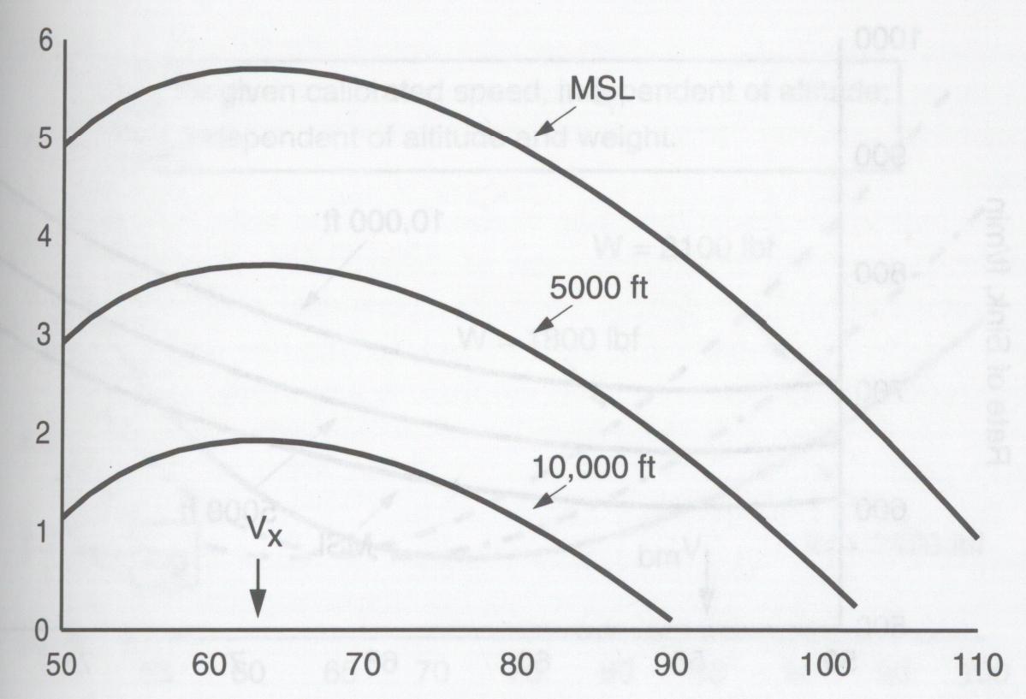
C-172 Climb Angle Versus Airspeed (Gross Weight)
Climb Angle  (deg)
V*
V (KCAS)
“Performance of Light Aircraft “ by J.T. Lowry

Slide 15
C-172 Rate of Climb Versus Airspeed
Rate of Climb (ft/min)
V_{Y}
V*
V (KCAS)
“Performance of Light Aircraft “ by J.T. Lowry

Slide 16
Parameters Used to Create Chart of Minimum Required Runway Length Versus Distance From DER
Use procedure for short-field take-off over 50 ft obstacle
L₁ obtained from POH
Accelerate to V* =75KIAS
L₂ = 600 ft which is obtained by assuming a 5 sec elapsed time to accelerate from V_{X} to V*
h=50 ft which is determined from the average speed and climb angle over the distance L₂
Climb angle at 75KIAS – 5.25 degrees

Slide 17
Parameters Used to Create Chart of Minimum Required Runway Length Versus Distance From DER (Cont.)
Assume 5 secs after engine failure before aircraft starts turn-back maneuver
L_{Human_Factors} = 600 ft based on the average speed in decelerating from V* to V₁
No altitude loss in this segment (=0 )
Non-zero value of  can be included by a simple modification to the end result which increments the required runway length
*

Slide 18
C-172 Minimum Runway Length for Turn-back Maneuver (Gross Weight, Sea Level, No Wind Case, Flight Path Angle for Climb  – 5.25 degrees)

Slide 19
C-172 Minimum Runway Length for Turn-back Maneuver (Gross Weight, Sea Level, No Wind Case, Flight Path Angle for Climb  – 5.25 degrees)

Slide 20
C-172 Expected Height Above DER (Gross Weight, Sea Level, No Wind) Flight Path Angle for Climb 5.25 deg
*

Slide 21
How Do We Know that both Aircraft and Pilot are Performing Correctly?

Slide 22
Three Opportunities to Check Both Aircraft and Pilot Performance Before Executing a Turn-back Maneuver
Check distance down the runway at lift-off (compare with POH)
Check distance down the runway when aircraft is 50 feet above the surface (compare with POH)
Check altitude (H_{L}) of the aircraft at the DER
If altitude at DER does not correspond to at least H_{L}
Revert to straight ahead procedure in case of engine failure
*

Slide 23
Executing Turn-back Maneuvers at High Density Altitude Airports

Slide 24
Why are the Cards Stacked the Against the Pilot in Attempting this Maneuver?
Altitude loss is affected by the density in the turning segments of the maneuver
Altitude loss per degree of turn varies inversely with the density of the air
Higher altitude translates into increased altitude loss in the turns
For the same KCAS the TAS is higher at higher density altitudes
Increases radius of the turn in segments 1 and 3
Impossible turn-back zone increases in length
Final intercept angle increases since for a given distance from the DER the value of D/R decreases
Increases altitude loss in segment 3 due to increase value of 

Slide 25
Why are the Cards Stacked Against the Pilot in Attempting this Maneuver? (Cont.)
Take-off performance degraded at high density altitude
Requires more runway length for TOD over 50 foot obstacle
Requires longer distance to accelerate to V*
Distance between the point of the engine failure and initiation of first turn increases
Climb angle is reduced compared to sea level climb angle
Sea Level -  = 5.25 deg
5000 ft altitude -  = 3.25 deg
Overall effect
Greater altitude loss in turn-back
Significantly longer required runway lengths for a potentially successful turn-back maneuver
*

Slide 26
How Much Time Elapses When Performing a Teardrop Turn-back Maneuver?

Slide 27
Elapsed Time for Execution of the Turn-back Maneuver in C-172 (Gross Weight, Sea Level, No Wind)
Rate of Turn in Segment 1 = 16.3 deg/sec
Rate of Turn in Segment 3 = 4.4 deg/sec
Time to Glide in Segment 2 = 0.0091 * Distance
Distance from DER (ft) | Time (sec)
1320 (1/4 sm) | 28
2640 (1/2 sm) | 40
5280 (1 sm) | 64
*

Slide 28
What About Lowering the Gear in a Complex Aircraft?
Do not lower gear prior to completing segment 1 turn
L/D ratio is reduced with the gear down due to the increase in the parasite drag
Gear should be lowered in segment 2
Need to know best glide speed for the weight of the aircraft with the gear down

Slide 29
What About Lowering the Gear in a Complex Aircraft? (Cont.)
Time to complete the turns in both segment 1 and 3
Knowing the duration of time for all 3 segments and the time it takes to lower and lock the gear provides the necessary information to determine when the gear should be lowered in segment 2
Inability to lower the gear in segment 2 would indicate that the turn-back maneuver should probably not be executed unless you are willing to land gear-up
*

Slide 30
Taking Another Look at the Keyhole/Racetrack Turn-back Scenario

Slide 31
Racetrack Turn-back Maneuver
Scenario 1: Gross weight, sea level, no wind case
360 degree turn at 45 deg bank angle
Remaining runway length at least 1500 feet from start of turn-back
Minimum required runway length – 7100 feet
190 feet altitude loss per 180 deg turn
Climb angle at V* - 5.25 deg
1500 feet

Slide 32
Racetrack Turn-back Maneuver (Cont.)
Scenario 2: Gross weight, sea level, no wind case
Turn-back initiated at the DER
Two 180 deg turns at 45 deg bank angle
Straight leg of 1500 feet at max L/D
Minimum required runway length – 7500 feet
1500 feet

Slide 33
Racetrack Turn-back Maneuver (Cont.)
Can Racetrack turn-back be used to fill the gap where the teardrop turn-back cannot be used?
Assume turn-back started 800 feet from DER
Additional 800 feet traveled past the DER requires additional 800 feet of runway (gliding back to DER)
Minimum runway length required – 8300 feet
Keyhole scenario would require slightly more runway than racetrack scenario
Depends on the ratio of and wind direction
*

Slide 34
Runway Length of Airports Between Santa Barbara and North San Diego County With Elevations Below 1000 Feet MSL (23 Airports)
Airport | Runway Length | Number or Runways
Whiteman | 4120 | 1
Santa Paula | 2665 | 1
Santa Monica | 4973 | 1
Hawthorne | 4956 | 1
Torrance | 5001/3000 | 2
Compton | 3322/3322 | 2
Long Beach | 10000/6192/5423 | 3
Santa Ana | 5700/2887 | 2
Van Nuys | 8001/4011 | 2
Burbank | 6886/5801 | 2
Camarillo | 6010 | 1

Slide 35
Runway Length of Airports from Santa Barbara to North San Diego Country With Elevations Below 1000 Feet MSL (23 Airports Cont.)
Airport | Runway Length | Number of Runways
Brackett | 4839/3661 | 2
Upland | 3864 | 1
El Monte | 3995 | 1
Corona | 3200 | 1
Chino | 7000/4919/4858 | 3
Riverside | 5401/2850 | 2
Fullerton | 3121 | 1
Carlsbad | 4897 | 1
Oceanside | 2712 | 1
Oxnard | 5950 | 1
Santa Barbara | 6052/4184/4180 | 3
San Bernardino | 10001 | 1

Slide 36
How Many of These 23 Airports Can a C-172 Execute a Potentially Successful Turn-back Maneuver
Using a teardrop turn-back maneuver?
10 airports
Using a keyhole/racetrack turn-back maneuver?
3 airports
Does this get your attention?
*

