Slide 1
“Single-Engine Failure After Takeoff: The Anatomy of a Turn-back Maneuver” Part 2
Les Glatt, Ph.D.
ATP/CFI-AI
VNY FSDO FAASTeam Representative
lgtech@roadrunner.com
(818) 414-6890
Checked Out From The SAFE Members Only Resource Center
Society of Aviation and Flight Educators – www.safepilots.org

Slide 2
Aircraft in a Steady Gliding Turn

Slide 3
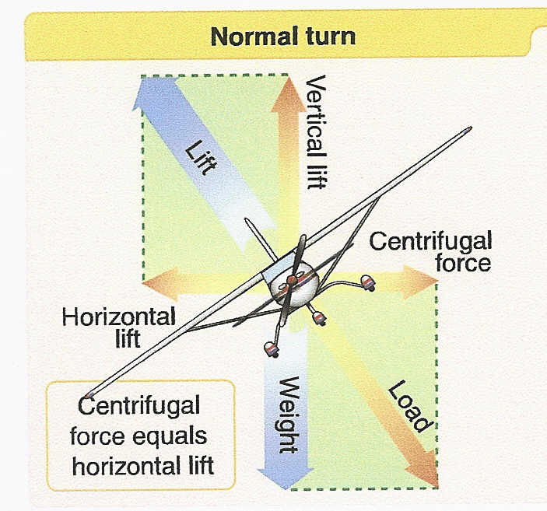
Force Balance During a Steady Gliding Turn
☞ is the bank angle
Vertical lift component = Component of Weight perpendicular to flight path
Horizontal Component of Lift = Centrifugal force
Radius of turn -
Rate of turn
☞
Q*

Slide 4
Parameters that Characterize a Steady Gliding Turn
Airspeed (V)
Turn radius (R)
Bank angle ()
Flight path angle ()
Angle-of-attack ()
Rate of turn is not necessary since we have included both airspeed and turn radius

Slide 5
How Do We Select the Variables for the Turn-back Maneuver?
Three relationships exist between the 5 variables
Balance of forces along the flight path
Balances of forces perpendicular to the flight path
Balance of forces in the plane of the turn
Two of the variables can be chosen arbitrarily
As pilots we can easily observe two of the 5 variables
Bank angle (attitude indicator)
Airspeed (airspeed indicator)

Slide 6
What is the Second Myth of Gliding Flight?
While the aircraft is in a gliding turn what bank angle should be utilized to minimize the altitude loss?
Shallow- less than 25 degrees
Medium- between 25-35 degrees
Steep- greater than 35 degrees
Is there a limit on how large a bank angle you would use?
Answer- There is one bank angle that will minimize the altitude loss in the gliding turn
It is between 45 and 46 degrees
You Will See Why in the Discussion that Follows

Slide 7
What is Glide Path Angle in a Turn?
General expression for the glide path angle can be obtained by looking at the balance of forces
Along flight path
Perpendicular to flight path

Slide 8
How Do We Determine the Altitude Loss in the Turn-back Maneuver?
Notes:
. .

Slide 9
Determining the Altitude Loss in the Turn-back Maneuver
Determine the altitude loss in each of the three segments of the turn-back maneuver and add them up
Segment 1: Initial Gliding turn
Segment 2 : Wings-level glide
Segment 3: Final Gliding turn

Slide 10
How Do We Determine the Altitude Loss in a Steady Gliding Turn?
Notes:
. .

Slide 11
Determining the Altitude Loss in a Steady Gliding Turn
If we know
Vertical speed of the aircraft (rate of descent) in feet/sec
Rate of turn of the aircraft in degrees/sec
Then the altitude loss per degree of turn is just
Altitude loss is just the altitude loss per degree of turn multiplied by the number of degrees the aircraft turns

Slide 12
Altitude Loss During Gliding Turns
In segments 1 and 3
Altitude loss per degree of heading change
F₁ = Aircraft Weight/Wing Area
Wing Loading
F₂ = Density of the air
Density altitude
F₃ = Bank Angle Function
Controlled by the pilot
Slight L/D
Dependence
F₄ = C_{L} L/D
Aircraft Aerodynamics
Controlled by the pilot

Slide 13
How Does Aircraft Weight (F₁) Effect the Altitude Loss in a Turn-back Maneuver

Slide 14
Weight Effect on Altitude Loss in Turn-back Maneuver (F₁)
Percent Below Gross Weight | Percent Reduction in Altitude Loss
0 | 0
5 | 5
10 | 10
15 | 15
20 | 20
Predicated on appropriate reduction of airspeeds with reduction in weight

Slide 15
Airspeed Variation with Reduction in Weight
Percent Below Gross Weight | Percent Reduction in Airspeed
0 | 0
5 | 2.5
10 | 5.1
15 | 7.8
20 | 10.5
Rule of thumb: Reduce airspeed by ½ the percentage below gross weight

Slide 16
How Does Density Altitude (F₂) Effect the Altitude Loss in the Turn-back Maneuver
Notes:
. .

Slide 17
Density Altitude Effect on Altitude Loss in the Turn-back Maneuver (F₂)
Density Altitude (feet) | Percent Increase in Altitude Loss
Sea Level | 0
1000 | 3
2000 | 6
3000 | 9
4000 | 13
5000 | 16
6000 | 20
7000 | 23
8000 | 27
Pressure Altitude and Temperature
Density Altitude

Slide 18
How Does Aircraft Aerodynamics (F₄) Effect the Altitude Loss in the Turn-back Maneuver?

Slide 19
Aerodynamic Function – F₄ for a C-172

Slide 20
Aerodynamic Function – F₄ (Cont.)
Plot of C_{L} L/D shows that it is a maximum at the accelerated stall speed of the aircraft (for all aircraft)
Need to select a margin of safety in the speed for the turn-back maneuver
Select a speed of 10 percent above the accelerated stall speed corresponding to whatever bank angle will be used for the turn
Operating at this angle-of-attack only gives up 11% additional altitude loss per degree of turn as compared to operating at the accelerated stall speed

Slide 21
Variation of C_{L}*L/D versus C_{L} for C-172

Slide 22
How Does Bank Angle (F₃) Affect the Altitude Loss in the Turn-back Maneuver?

Slide 23
Bank Angle Function F₃ for C-172
F₃
F₃ is minimum at 45.4 deg
Bank Angle (deg)

Slide 24
How Can We Minimize the Altitude Loss in Segment 1?
The term which is a function of bank angle will minimize the altitude loss in segment 1 if the bank angle is between 45 and 46 degrees
Depends on the value of L/D
45 degrees at very large values of L/D
Load factor at 45 deg bank is 1.41
We satisfy the previous turn-back guideline of “Do not bend the aircraft”
C-172 airspeed would be 65KIAS
Advantage of 65 KIAS in a C-172 is that it is the same airspeed used for the
wings-level glide speed at gross weight (i.e. entire turn-back maneuver flown at 65 KIAS)

Slide 25
Comparison of Flight Characteristics for a 20, 45, and 70 Degree Bank Angle Turn-back Maneuver for C-172
Parameter | 20 deg | 45 deg | 70 deg
Load Factor
1.1 * V_{AS} (Kts)
Turn Radius
Glide Path Angle (deg)
Rate of Turn (deg/sec)
Rate of Descent (ft/min)
F₃
Altitude loss ( ft/deg)

Slide 26
Comparison of Flight Characteristics for a 20, 45, and 70 Degree Bank Angle Turn-back Maneuver for C-172
Parameter | 20 deg | 45 deg | 70 deg
Load Factor | 1.06 | 1.41 | 2.92
1.1 * V_{AS} (Kts)
Turn Radius
Glide Path Angle (deg)
Rate of Turn (deg/sec)
Rate of Descent (ft/min)
F₃
Altitude loss ( ft/deg)

Slide 27
Comparison of Flight Characteristics for a 20, 45, and 70 Degree Bank Angle Turn-back Maneuver for C-172
Parameter | 20 deg | 45 deg | 70 deg
Load Factor | 1.06 | 1.41 | 2.92
1.1 * V_{AS} (Kts) | 56.5 | 65.0 | 91.5
Turn Radius
Glide Path Angle (deg)
Rate of Turn (deg/sec)
Rate of Descent (ft/min)
F₃
Altitude loss ( ft/deg)

Slide 28
Comparison of Flight Characteristics for a 20, 45, and 70 Degree Bank Angle Turn-back Maneuver for C-172
Parameter | 20 deg | 45 deg | 70 deg
Load Factor | 1.06 | 1.41 | 2.92
1.1 * V_{AS} (Kts) | 56.5 | 65.0 | 91.5
Turn Radius | 784 | 384 | 285.4
Glide Path Angle (deg)
Rate of Turn (deg/sec)
Rate of Descent (ft/min)
F₃
Altitude loss ( ft/deg)

Slide 29
Comparison of Flight Characteristics for a 20, 45, and 70 Degree Bank Angle Turn-back Maneuver for C-172
Parameter | 20 deg | 45 deg | 70 deg
Load Factor | 1.06 | 1.41 | 2.92
1.1 * V_{AS} (Kts) | 56.5 | 65.0 | 91.5
Turn Radius | 784 | 384 | 285.4
Glide Path Angle (deg) | 7.1 | 9.3 | 18.8
Rate of Turn (deg/sec)
Rate of Descent (ft/min)
F₃
Altitude loss ( ft/deg)

Slide 30
Comparison of Flight Characteristics for a 20, 45, and 70 Degree Bank Angle Turn-back Maneuver for C-172
Parameter | 20 deg | 45 deg | 70 deg
Load Factor | 1.06 | 1.41 | 2.92
1.1 * V_{AS} (Kts) | 56.5 | 65.0 | 91.5
Turn Radius | 784 | 384 | 285.4
Glide Path Angle (deg) | 7.1 | 9.3 | 18.8
Rate of Turn (deg/sec) | 7.0 | 16.5 | 31.0
Rate of Descent (ft/min)
F₃
Altitude loss ( ft/deg)

Slide 31
Comparison of Flight Characteristics for a 20, 45, and 70 Degree Bank Angle Turn-back Maneuver for C-172
Parameter | 20 deg | 45 deg | 70 deg
Load Factor | 1.06 | 1.41 | 2.92
1.1 * V_{AS} (Kts) | 56.5 | 65.0 | 91.5
Turn Radius | 784 | 384 | 285.4
Glide Path Angle (deg) | 7.1 | 9.3 | 18.8
Rate of Turn (deg/sec) | 7.0 | 16.5 | 31.0
Rate of Descent (ft/min) | 706 | 1088 | 2985
F₃
Altitude loss ( ft/deg)

Slide 32
Comparison of Flight Characteristics for a 20, 45, and 70 Degree Bank Angle Turn-back Maneuver for C-172
Parameter | 20 deg | 45 deg | 70 deg
Load Factor | 1.06 | 1.41 | 2.92
1.1 * V_{AS} (Kts) | 56.5 | 65.0 | 91.5
Turn Radius | 784 | 384 | 285.4
Glide Path Angle (deg) | 7.1 | 9.3 | 18.8
Rate of Turn (deg/sec) | 7.0 | 16.5 | 31.0
Rate of Descent (ft/min) | 706 | 1088 | 2985
F₃ | 1.54 | 0.99 | 1.47
Altitude loss ( ft/deg)

Slide 33
Comparison of Flight Characteristics for a 20, 45, and 70 Degree Bank Angle Turn-back Maneuver for C-172
Parameter | 20 deg | 45 deg | 70 deg
Load Factor | 1.06 | 1.41 | 2.92
1.1 * V_{AS} (Kts) | 56.5 | 65.0 | 91.5
Turn Radius | 784 | 384 | 285.4
Glide Path Angle (deg) | 7.1 | 9.3 | 18.8
Rate of Turn (deg/sec) | 7.0 | 16.5 | 31.0
Rate of Descent (ft/min) | 706 | 1088 | 2985
F₃ | 1.54 | 0.99 | 1.47
Altitude loss ( ft/deg) | 1.68 | 1.08 | 1.60

Slide 34
Bank Angle Limitation in Segment 3
Without power the aircraft cannot accelerate to higher speed to achieve the increased bank angle necessary to reduce the turn radius without a critical loss in altitude
Need to fly at V₂ in segment 3
Segment 3 bank angle is limited to insure the aircraft does not stall at V₂
Maximum bank angle in segment 3 corresponds to the load factor
Includes the 1.1 safety
Factor on V_{AS}

Slide 35
How Do We Create a Chart of Altitude Loss Versus Distance from the DER for a Turn-back Maneuver?

Slide 36
Criteria Used to Create a Table of Altitude Loss Versus Distance from the DER
Sum the altitude loss in each of the 3 segments
Segment 1: Initial turn
Bank angle – 45 degrees
V₁ = 1.1 * V_{AS} (10 % above accelerated stall speed)
Segment 2: Wings-level glide
V₂ = V_{Max} _{L/D}
Segment 3: Final turn
V₃ = V_{max} _{L/D}
Bank angle – 15 degrees

Slide 37
C-172 Aircraft Selected to for the Turn-back Maneuver

Slide 38
Flight Parameters for C-172 for the 3 Segments (Gross Weight at Sea Level, No Wind)
Segment 1
Bank angle – 45 degrees
Airspeed – 65 KIAS (10% above accelerated stall speed)
Radius of turn – 384 feet
Altitude loss – 1.08 ft/deg
Rate of descent -1088 ft/min
Segment 2
Bank angle – 0 degrees
Airspeed – 65 KIAS
Rate of descent – 723 ft/min
Segment 3
Bank angle – 15 degrees
Airspeed – 65 KIAS
Radius of turn – 1415 feet
Altitude loss – 2.8 ft/deg
Rate of descent – 746 ft/min

Slide 39
Total Altitude Loss for Turn-back Maneuver for C-172 (Gross Weight, Sea Level, No Wind)
Segment 3 Constraint - 15 deg bank angle

Slide 40
C-172 Runway Intercept Angle (No Wind Case)
*

Slide 41
Altitude Loss in Each Segment Versus Distance from DER for C-172 (Gross Weight, Sea Level, No Wind)
Region of
Impossible
Turn
Segment 2

Slide 42
Unusable Runway Length for 15 degree Bank in Segment 3 (Gross Weight, Sea Level, No Wind)

Slide 43
Risk Reduction
Notes:
. .

Slide 44
Risk Reduction
Chart of altitude loss during the turn-back maneuver versus distance from DER does not provide useful information to the pilot prior to departure
Pilot would need to monitor altitude versus distance from DER after take-off
Need to be able to make a determination prior to take-off if the turn-back maneuver falls in the envelope of the “Impossible-Turn-back” region”
Need a different type of chart for decision making

